Slide 1

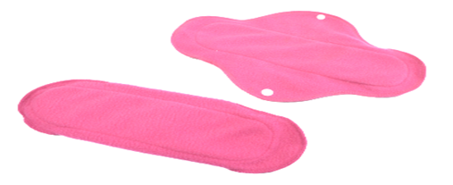
SAFE PADS
Dr. Vishva Jeotsna
Founder Director
Karunakar Singh
Founder Director
Website:http://prodigiousmanagement.com
9523097048

Slide 2




VISION
Innovate
We confront traditional solutions to the needs of the world’s poorest.
We innovate existing approaches to combating effects of poverty and reconfigure existing solutions in order to meet future needs.
We Use design, insight, technology, empathy and passion into every new product, solution, service or feature.
Market Research
88% women use home made products
12% women use commercial products
99% of commercial product sales are disposable sanitary napkins
Commercial sale of of all MHM products in 2014 grew by 15% to reach 3.9 billion units worth Rs 19.6 billion
3 International players occupy 75% of market share (2014)
P & G has 48 % of market share with Whisper choice & whisper ultra, targeting mid range and premium consumers
J & J’s stayfree has 25% market share
Kimberley clark’s kotex has 2.5% market share

Slide 3



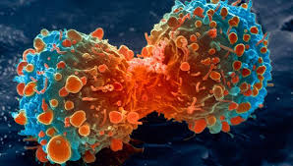
Better Health
Clean Environment
Economic Empowerment
355 million women girls menstruating
312.4 MILLION WOMEN & GIRLS age 15-49 yrs MENSTRUATING
NOT USING SANITARY PADS
Environmental pollution
Poor health
21.3 billion sanitary napkins thrown on land
SAFE PADS
42.6 MILLION USING
Out of pocket expenditure
Target Audience
88 % NOT USING
Non bio degradable
12% USING
PADS
Mounting debts
Unsafe menstrual hygiene
Landfills
Sewerage
Candidiasis
Low productivity
Fields
Water
75% women suffer
Cervical cancer
Vicious cycle of poverty
200 women die everyday
113000 ton/year

Slide 4
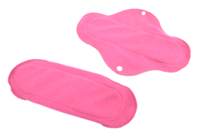








Solutions | Uniqueness
Women using grass, husks, rags have safe pads available, affordable at their door steps Safepad hygienic sanitary pads are designed with a permanently bonded antimicrobial technology that helps reducing vaginal infections caused by Candida albicans | “SAFE PAD is a reusable & anti-microbial sanitary pad provide a safe and infection free experience while in use”
NO SUN DRY required as Antimicrobial treatment will 30 crores production of napkins packets can produce 1 million jobs healthy menstruation and healthy environment, Can create livelihood, empowerment, income employment , high productivity Clean water, sanitation and healthy environment | Advantages of Safe Pad Anti-Microbial No Sun dry 12 months usage12 months life cycle Half an hour drying period Bio degradable Reusable Easily washabale Generates Employment Health and Hygiene Safepad is designed to provide a safe and infection free experience while in use. Comfortable Safepad is made of a soft fabric material that causes no irritation. Safepad fabric technology ensures high and immediate absorbency , non-leakage and quick drying after wash
 | 30
SDG s are Improved

Slide 5
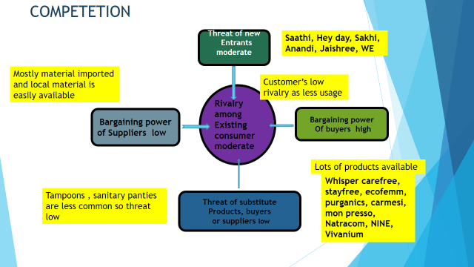

Slide 6
ACTION PLAN 2019-20
Activities | 1 | 2 | 3 | 4 | 5 | 6 | 7 | 8 | 9 | 10 | 11 | 12
Project Management Plan preparation
Recruitment of personnel and deputation
Trainings of personnel
Market research in the selected states
Introductory workshop with the government agency(s) responsible for state development planning and state statistics
Introductory workshop with remaining state government departments and other state level stakeholders
Introductory workshops in the cities with low indicators cities of the state governments
Advocacy- Stakeholders analysis Prioritization of stakeholders Development of strategies as per stakeholders Choosing the communication tool according to stakeholders Field testing the tools Choosing the platform for dissemination of communication messages Training of the officials and staff in the communication tool and strategy Implementing the Advocacy strategy
Networking with SHGs, AAAs, Girls schools, Rural Marts, PRI, NGOs for distribution of safe pads
Procurement of raw material and production of Safe Pads 17000 packs
Product distribution in NCR slums, cities with poor indicators in Uttar Pradesh, Bihar and Rajasthan
Satisfaction feedback of the beneficiaries
Monitoring & Evaluation

Slide 7
Social Marketing Promotion Strategy & Marketing Mix Strategy
-Community Led Menstrual Hygiene Sanitation campaign (CLMHS) -Events planned on Menstrual hygiene with school heads, women association leaders, dignitaries, slum representatives -SHGs, NGOs, Girls School heads, PRI members, VHSNC, VHSND, Anganwari centres, AAAs -Rallies on Menstrual hygiene with Women organizations representatives, school, college girls, Environmentalists -Media Advocacy news and print media & local channels -In villages Jan Jagran rallies with PRI members, VHSNC members, school representatives AAAs and communities -FGDs, & Social Media blasting -Community Radio -Puppetry, Print Media | Customer, Customer Satisfaction, Money Value , Brand Awareness Satisfaction Index Perception of Highest value Brand Recognition High quality Brand Association International Business Process, Implementation of CRM, Online Channel Efficiency Time to introduce new product On time delivery Delivery cycle time % of Customers call answered % Customers complaints settled % Customers retained Learning & Growth, People, Innovation Employee satisfaction Index Innovative packaging Employee suggestion Customer suggestion | Skimming price Cost leadership Price targeting lowest strata To cover a geographically dispersed market direct distribution channel is used 80% Social Marketing Marketing through SHGs, NGOs, rural marts 20% TV 2% Radio 5% Print Media 2 % Internet 2% Direct Marketing 70% Online marketing5% Public Relations Marketing Research 5% Training to the new staff to develop ‘Culture of Service’2% Meticulous recruitment process 1% Accountability of the Staff 5%
Strategy Short Term Strategy Long term Focus on 7Ps

Slide 8
Differentiator
“SAFE PAD is Anti-microbial, environment friendly sanitary pad designed to provide a safe and infection free experience and create gainful employment”

Slide 9
BUSINESS PLAN & PROJECTIONS

Slide 10
Details about company
Stage of your venture: Proof of concept completed
Contact number 9523097048
Email Id vishvajsingh@gmail.com
Website prodigiousmanagement.com
 | Name of the member | Email Id | Contact no. | Work Exp in yrs | Role in the venture
1 2 | Dr. Vishva Jeotsna Karunakar Singh | vishvajsingh@gmail.com k.karunakarsingh@gmail.com | 9523097048 9891636051 | 22 25 | Managing Director Director Social Marketing

